Slide 1


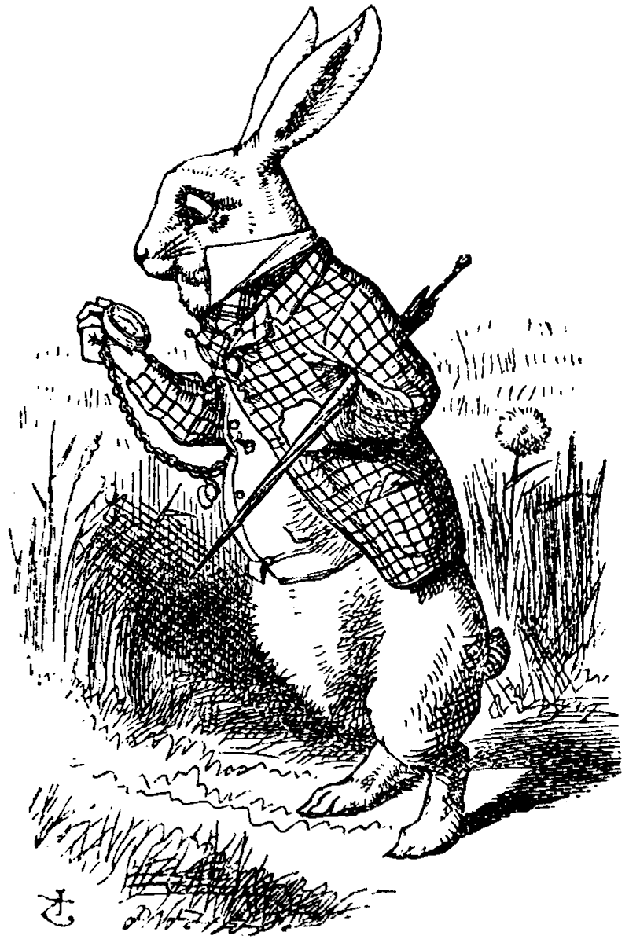
Magazine Formatting
John Tenniel, 1865

Slide 2
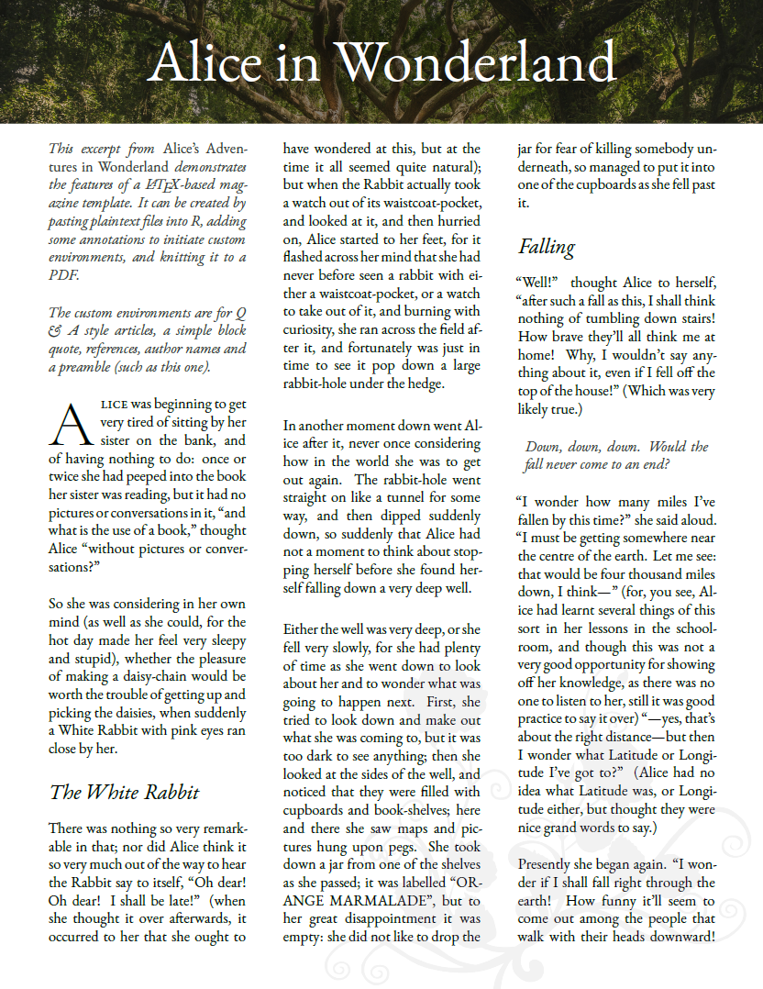

Slide 3
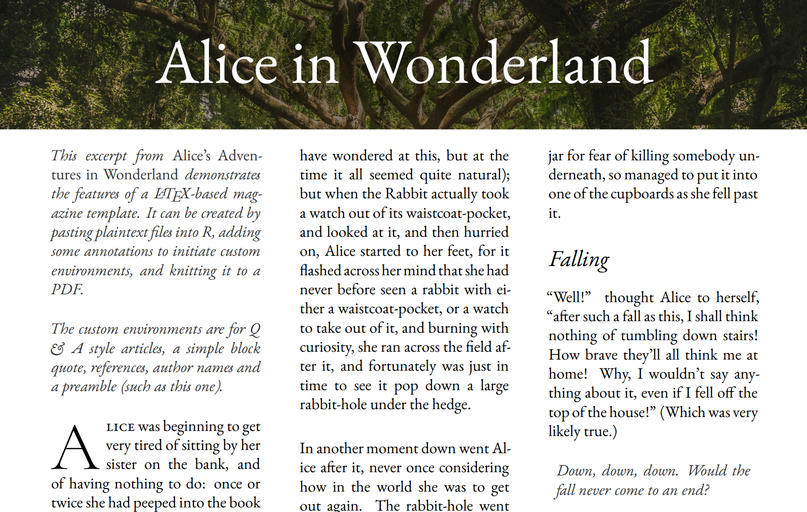
InsertBackgroundPicture
Section
preamble
Justifi-cation
subsection
lettrine
multicols
quote

Slide 4
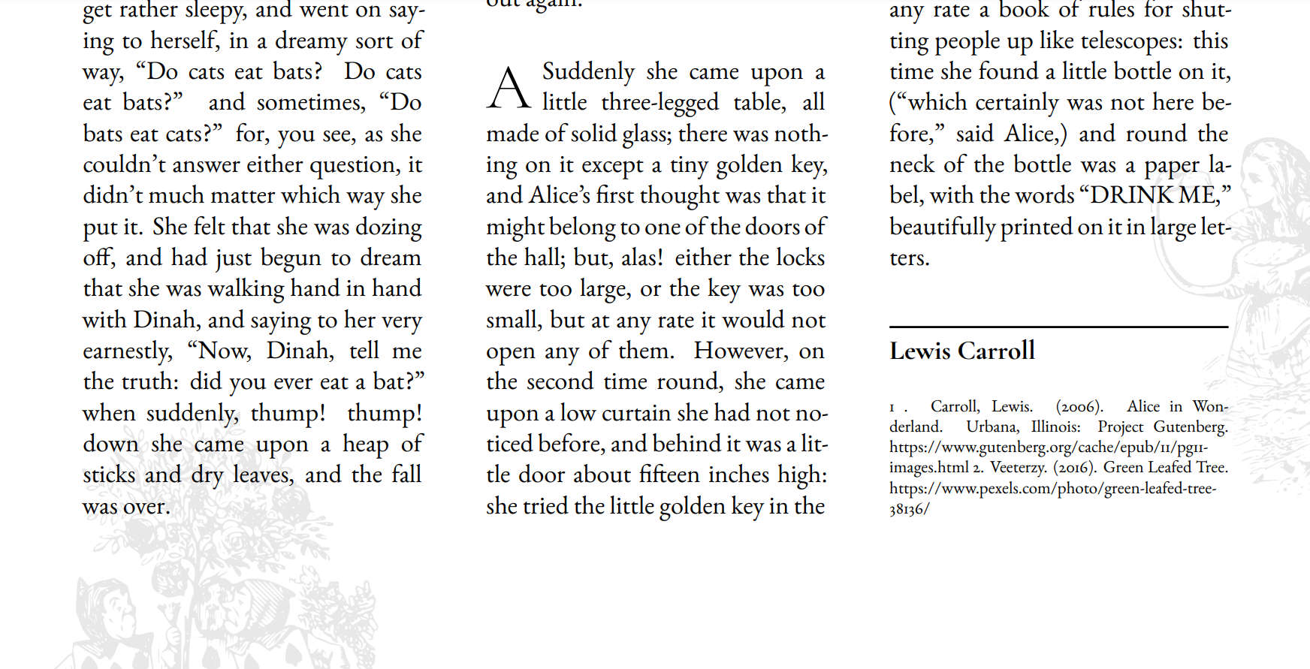
InsertBackgroundImage
author-name
Must use full-page (8.5 x 11 inch) background image
references

Slide 5
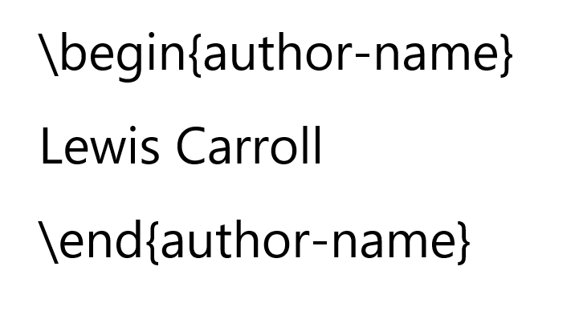

Authors

Slide 6

Use \section{} for the title

Slide 7
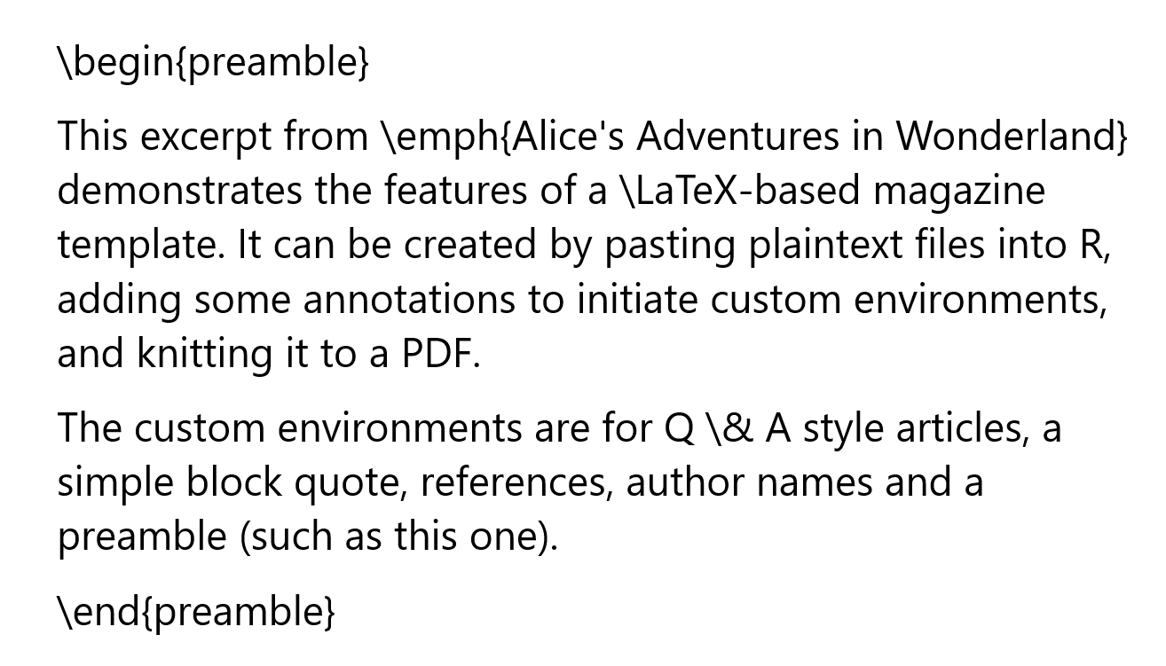
Use \begin{preamble} and \end{preamble}

Slide 8
Use \emph{} for emphasis
Note: There is no bold available

Slide 9

Use \& for ampersands

Slide 10
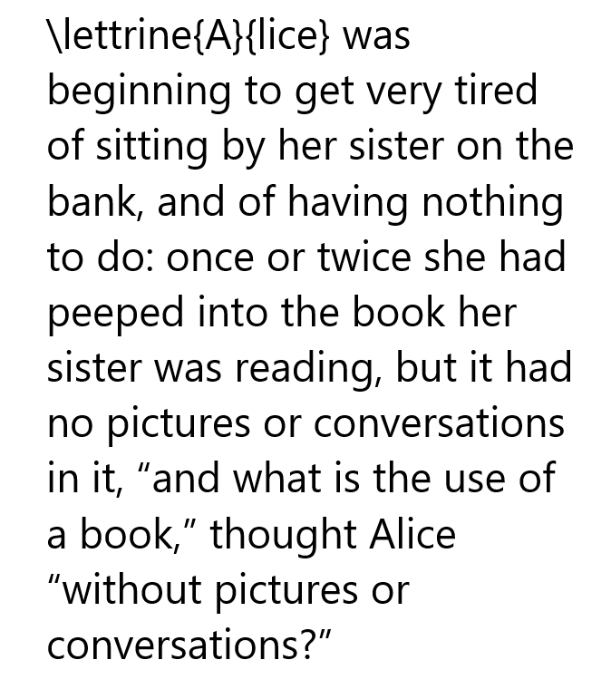
Use \lettrine{}{} for drop caps

Slide 11
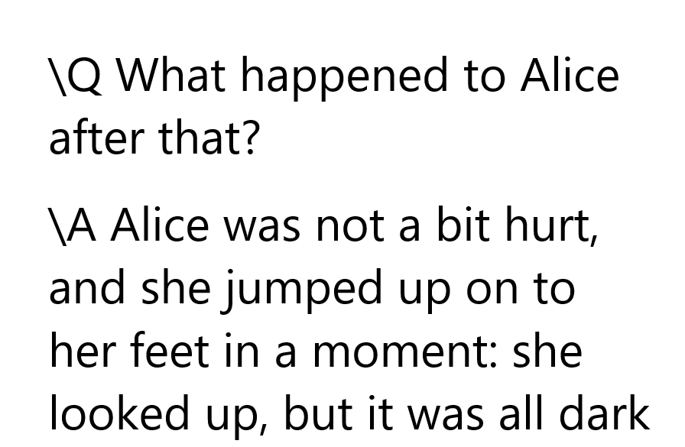
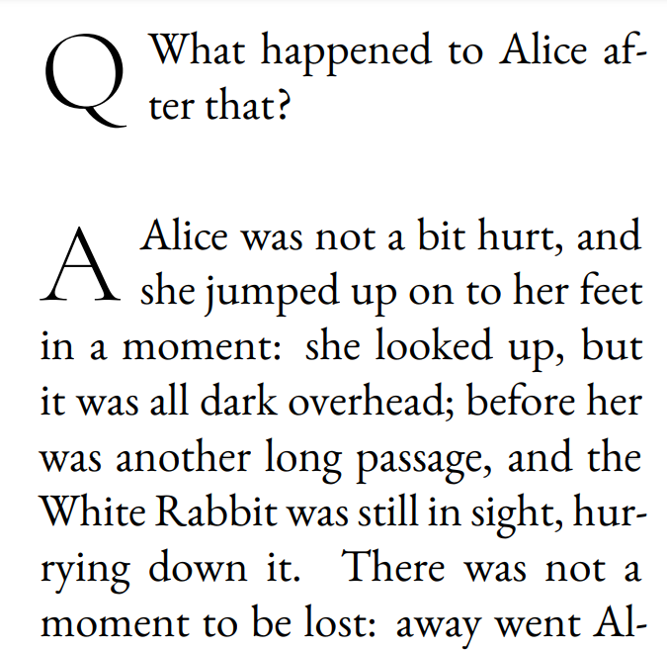
Use \Q and \A for questions

Slide 12
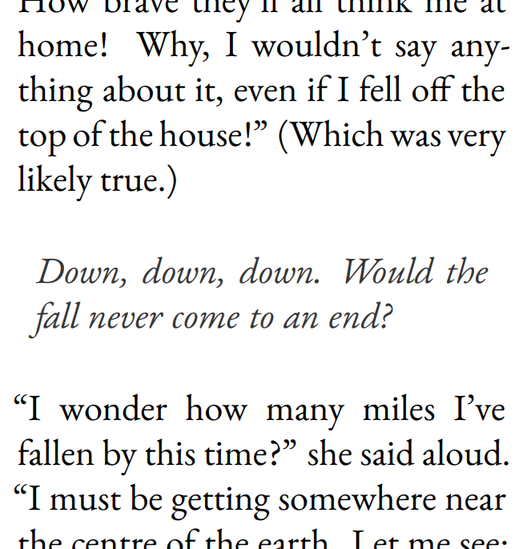
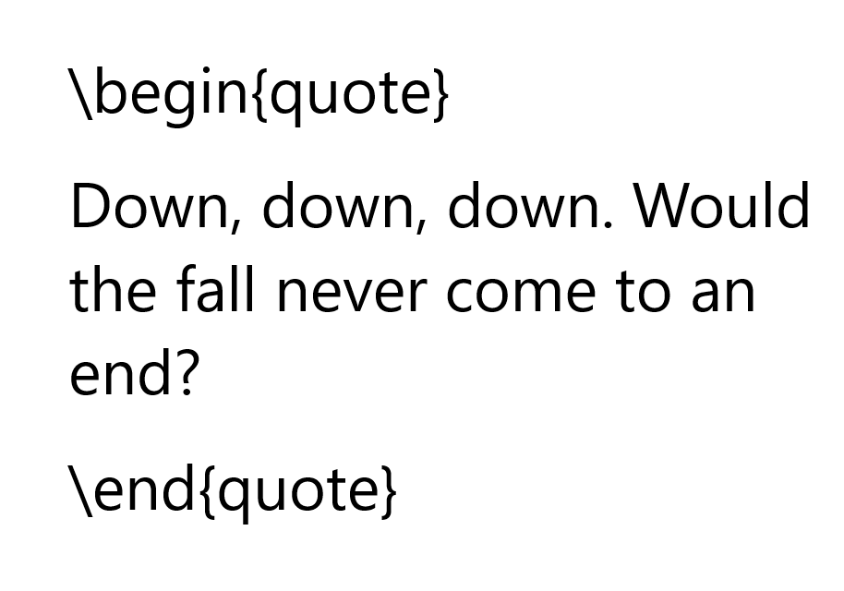
Quotes

Slide 13
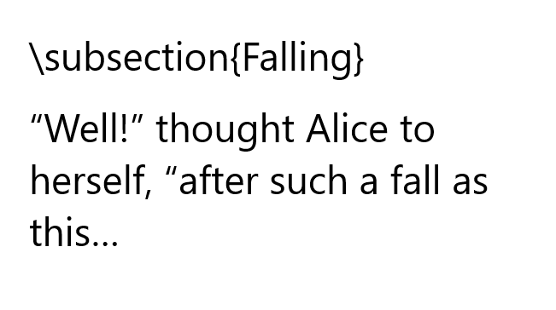
Use \subsection{} for headings

Slide 14
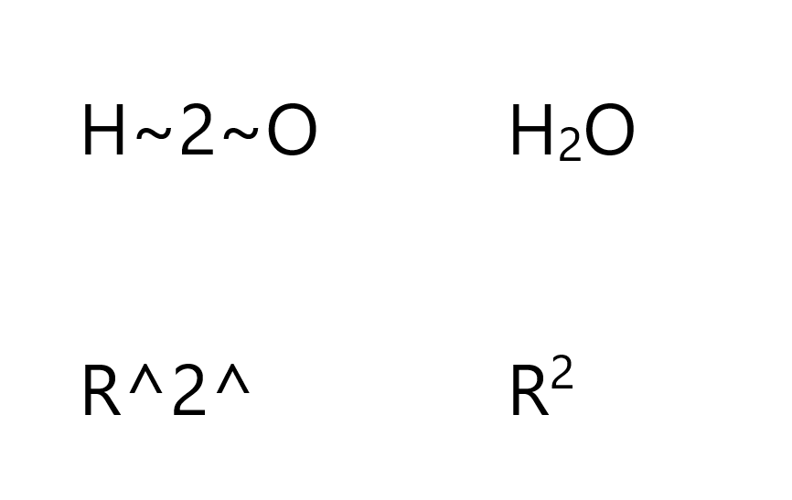
Subscripts and Superscripts

Slide 15

Images
\InsertBackgroundPicture{../Images/Alice-in-Wonderland-page-1.png}
32 px tall, or 1.384 inches tall
.png file
At least 300 DPI
Must be open source
8.5 in x 11 in

Slide 16
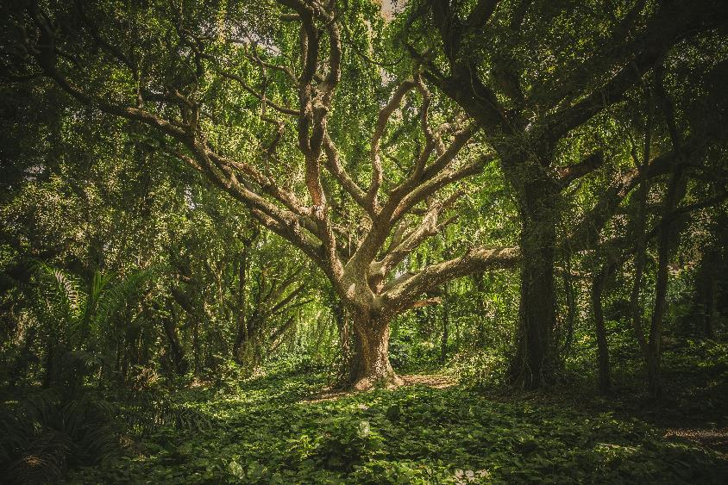
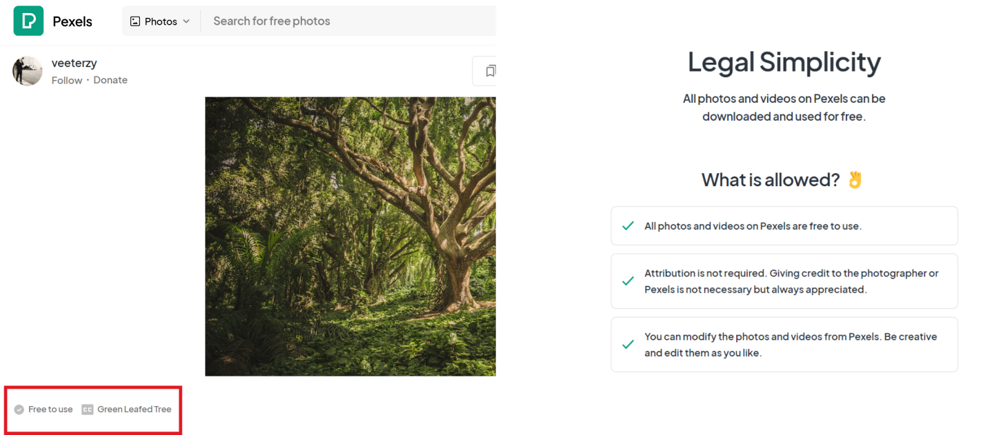
Images
Original Image
Open access proof (license screenshot)

Slide 17
InsertBackgroundPicture
Section
preamble
Justifi-cation
subsection
lettrine
multicols
quote

